Slide 1
E-Commerce Website
Shayon Dasgupta (23074026)
Soumadip Majumder (23074027)

Slide 2
Objective:
Design a website to manage E-commerce sales and database

Slide 3
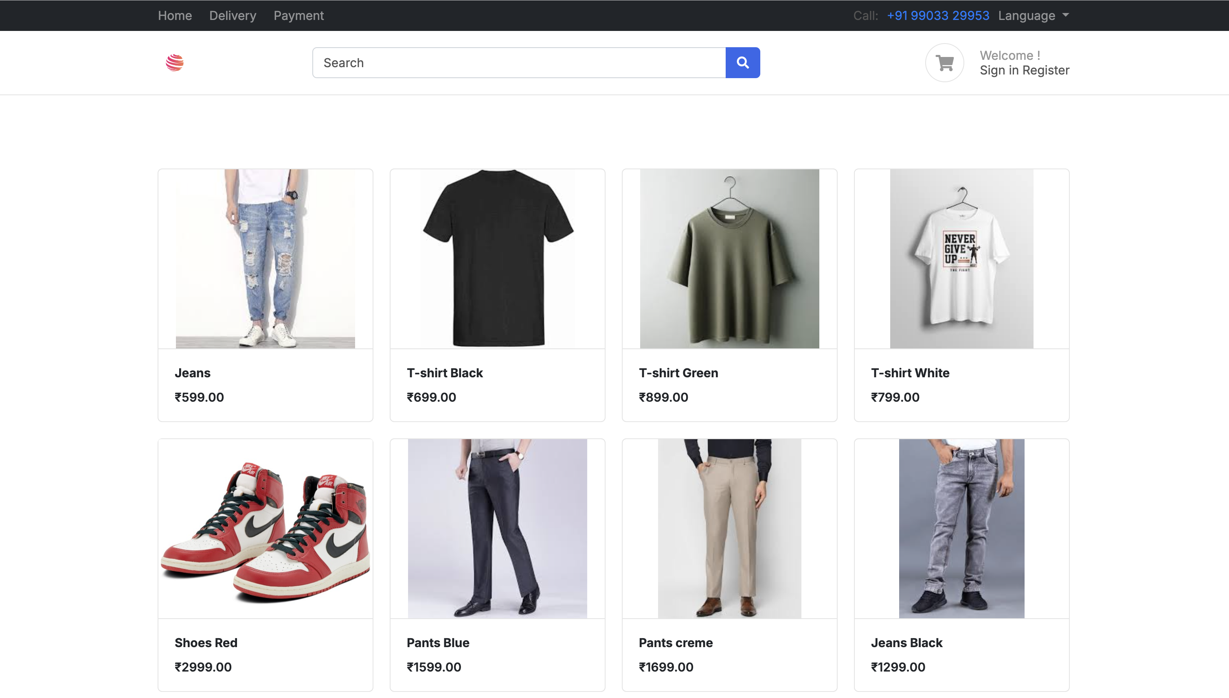
HOME PAGE

Slide 4
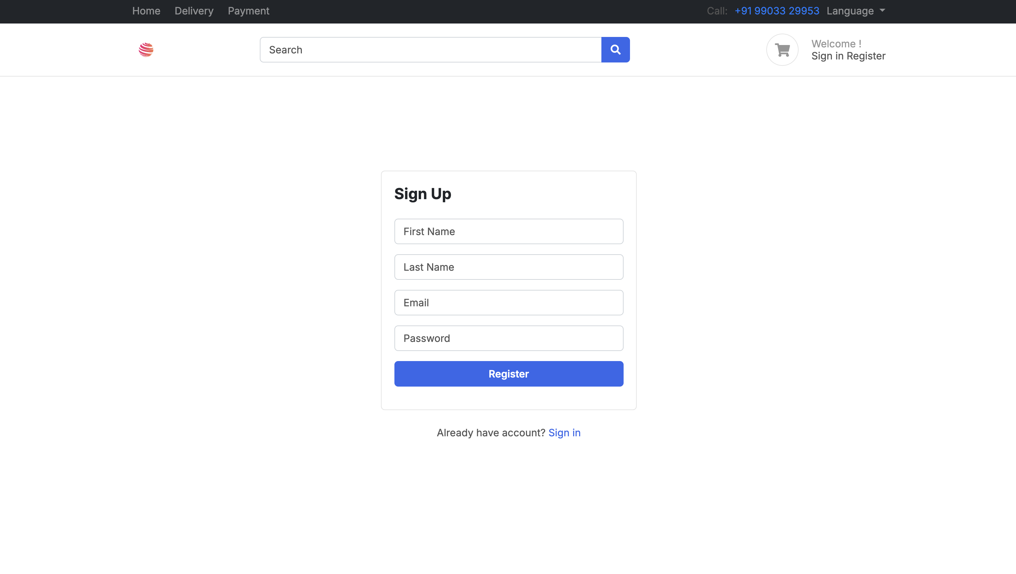
SIGN UP OR REGISTER PAGE

Slide 5
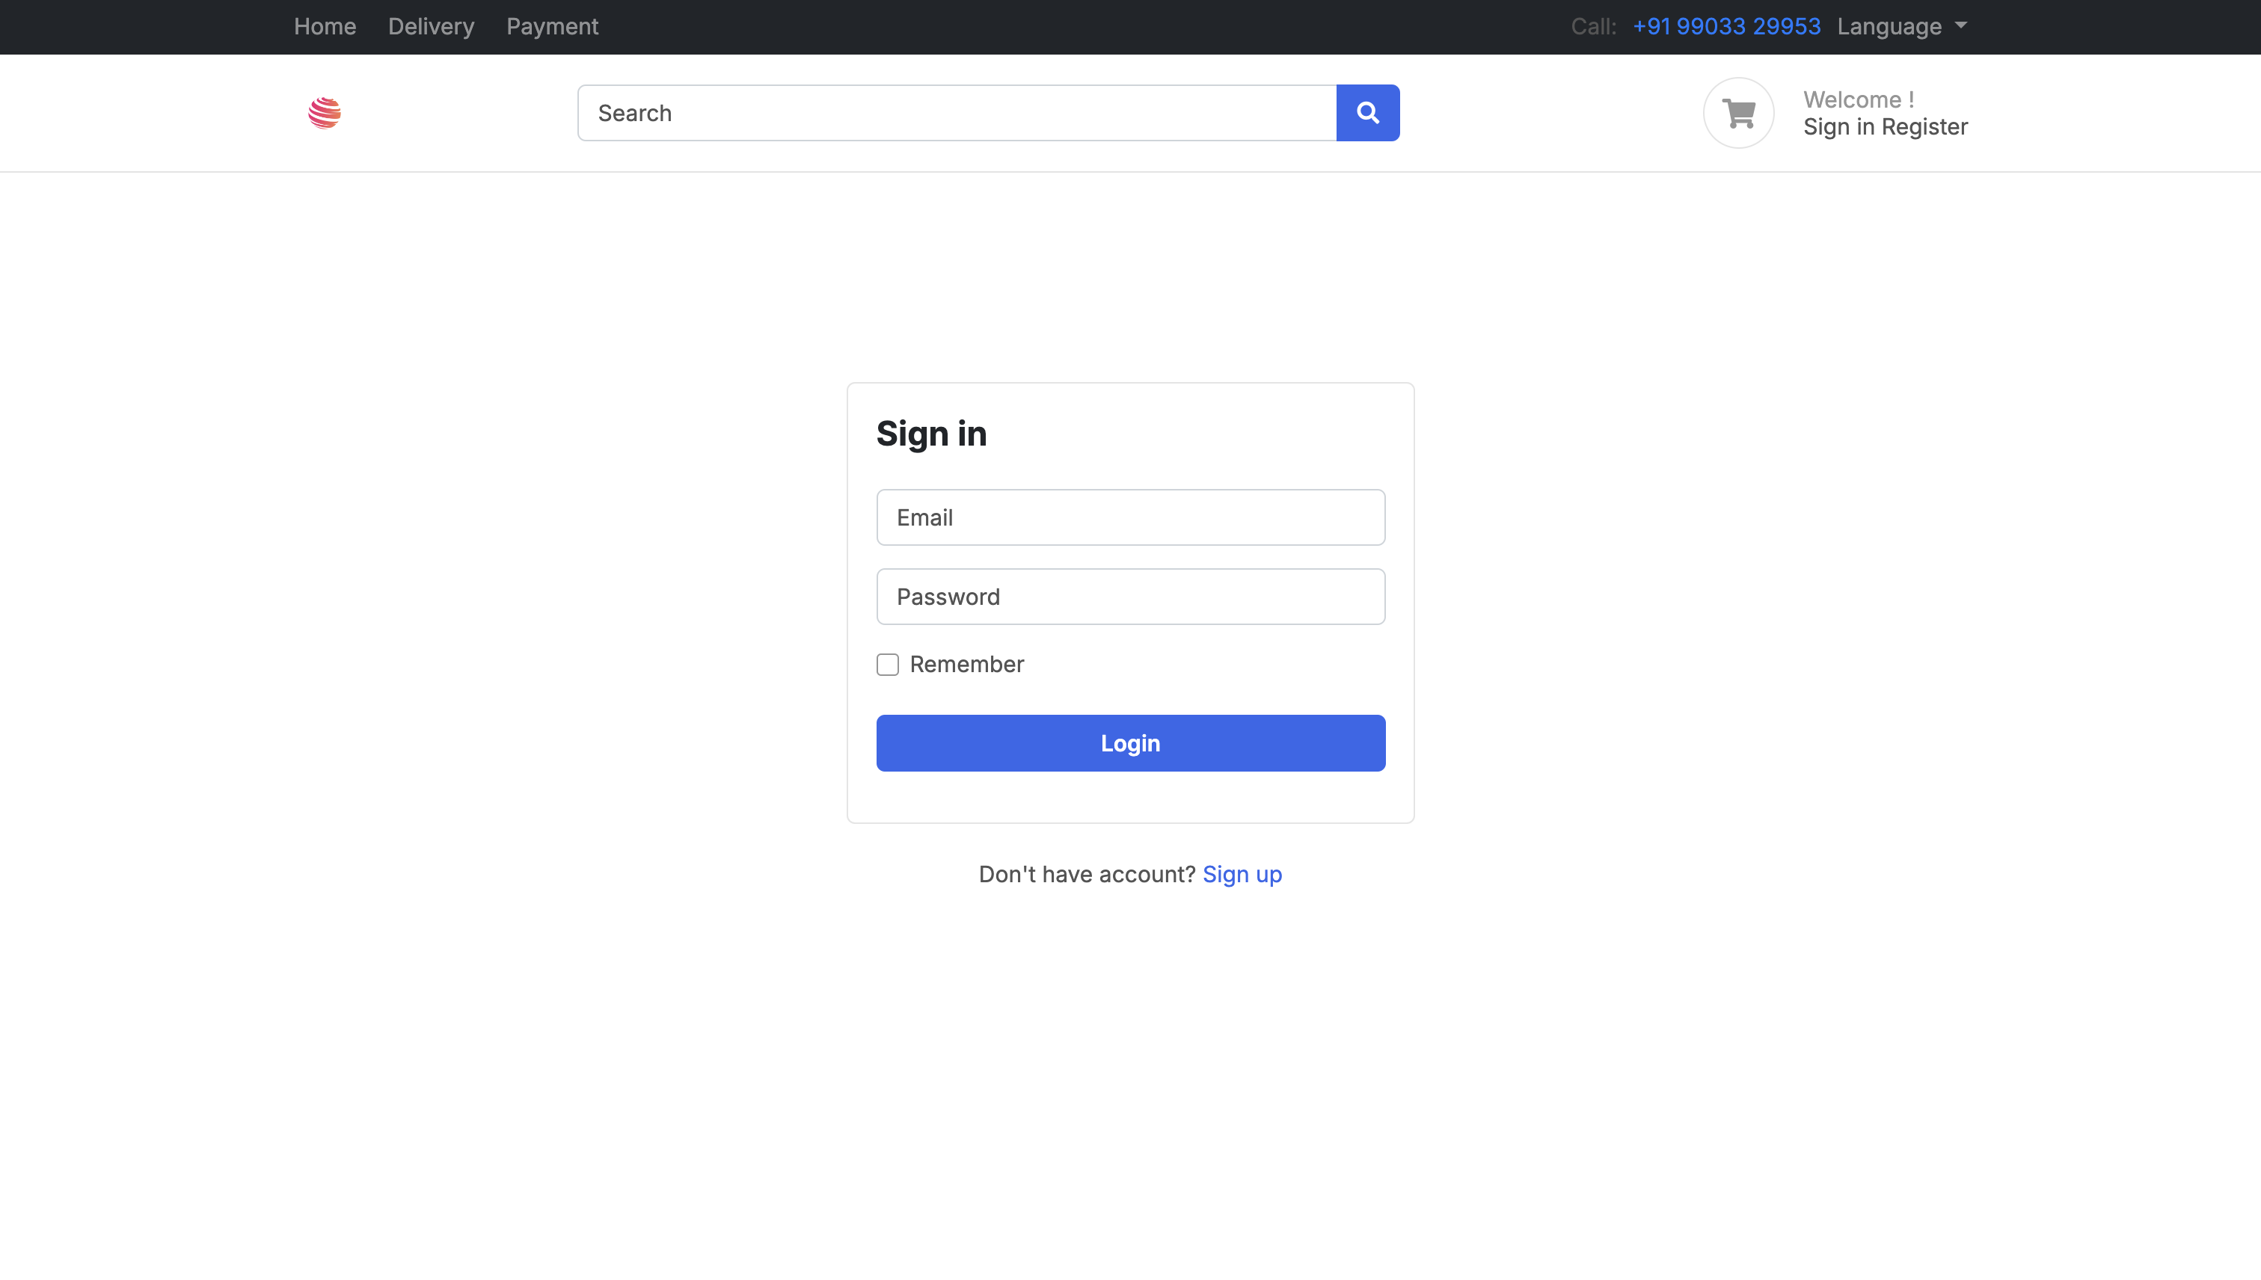
SIGN IN PAGE

Slide 6
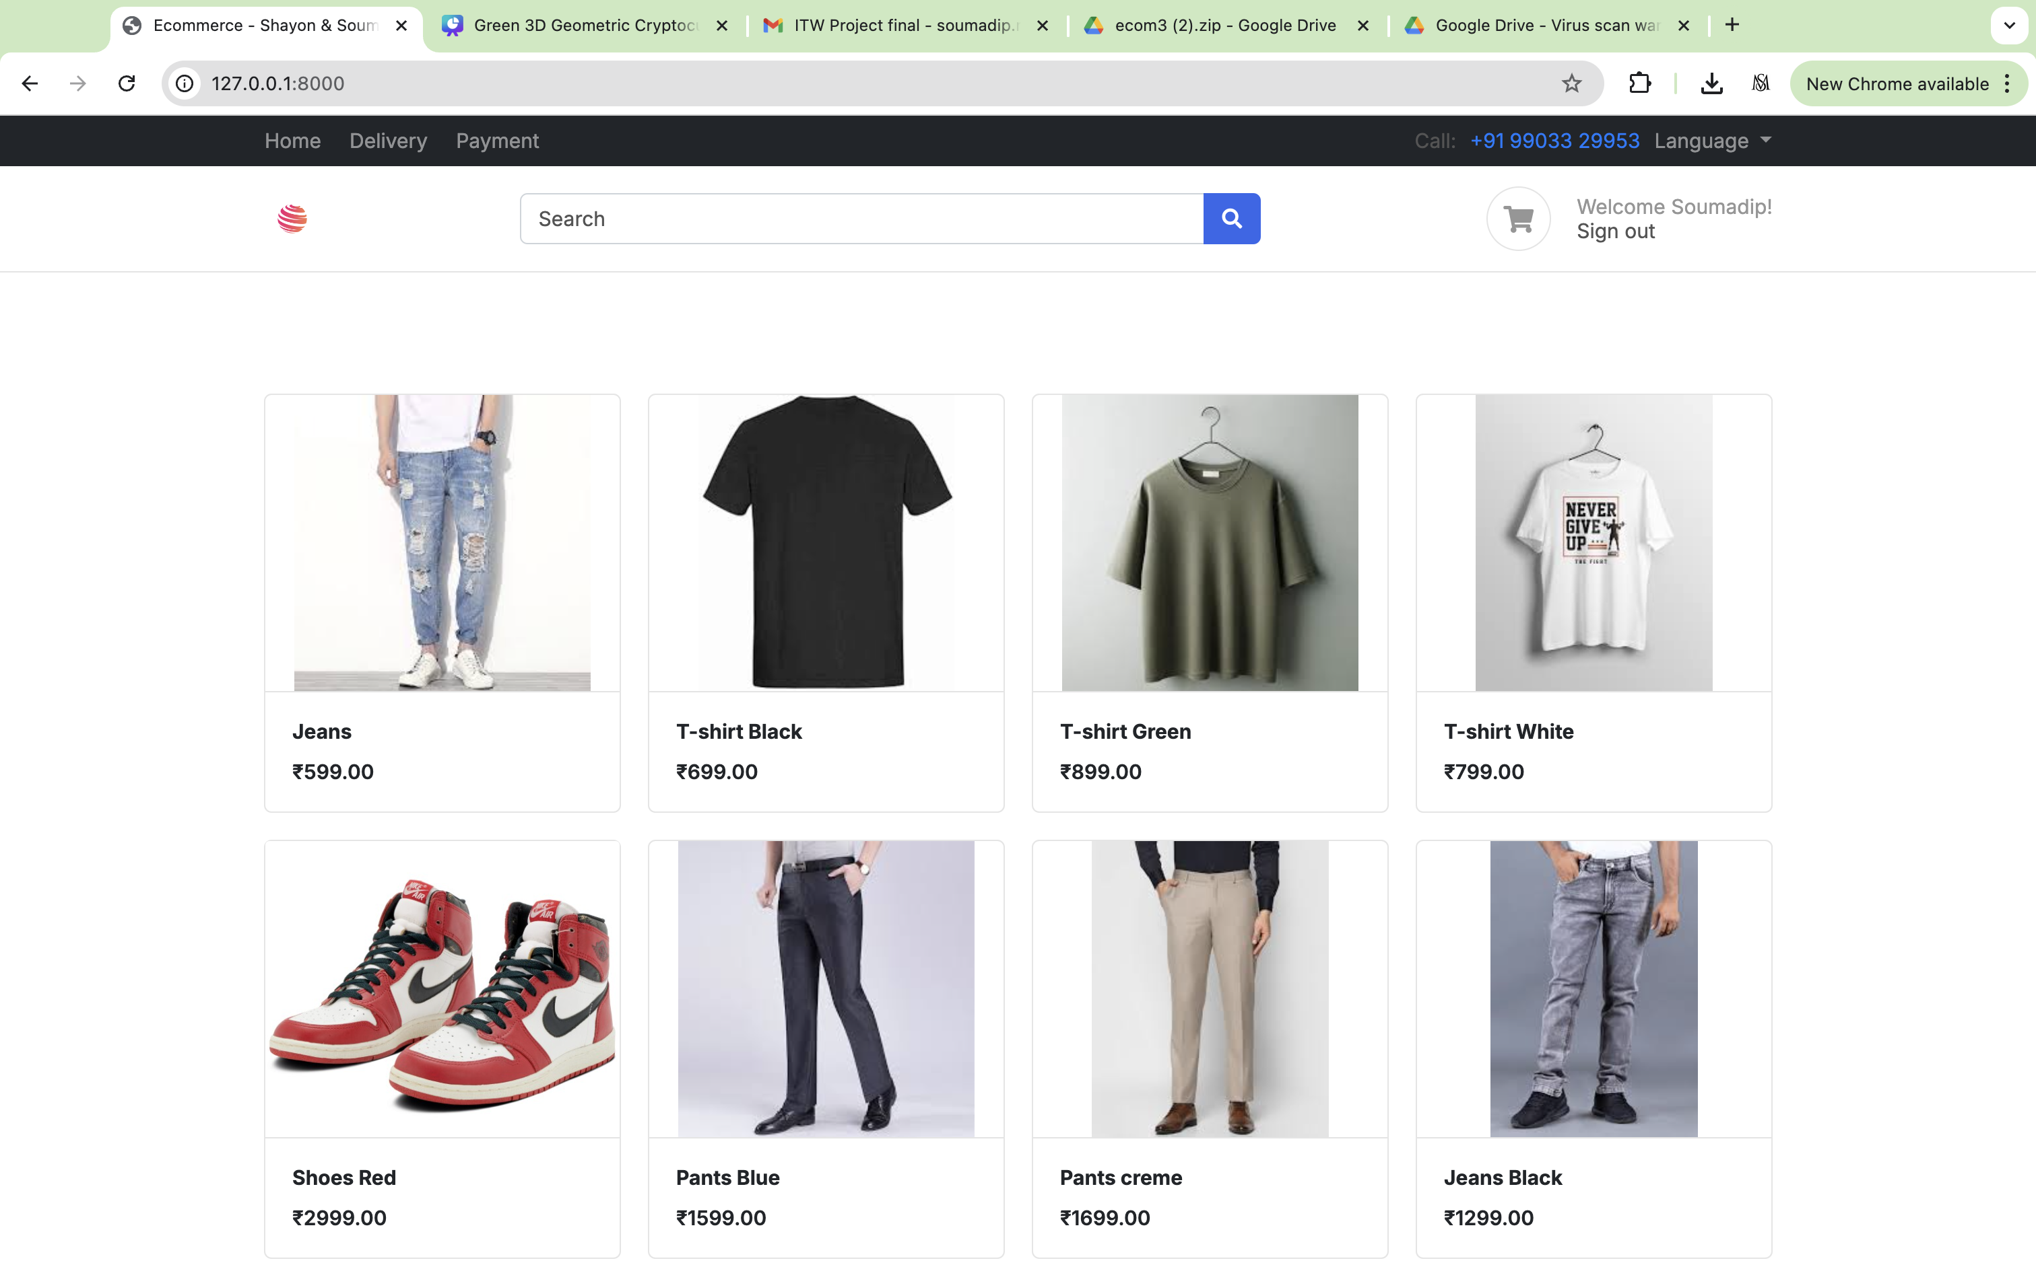
HOME PAGE AFTER SIGN IN:

Slide 7
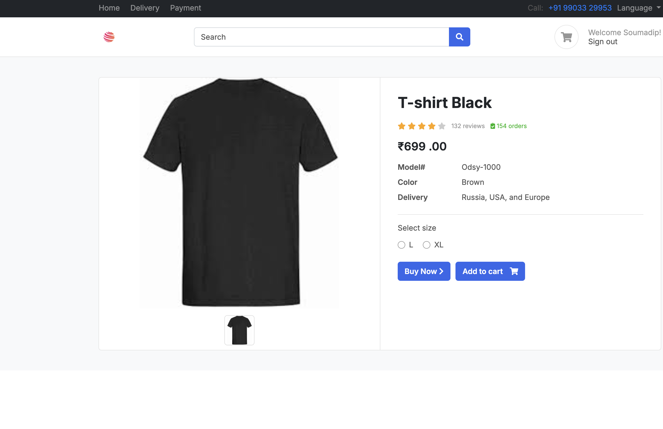
PRODUCT PAGE
Has functional Radio buttons for size L and Xl.
Has functional direct buy link which redirects to razorpay website for checkout.
Has functional Add to cart button which adds product to cart.

Slide 8
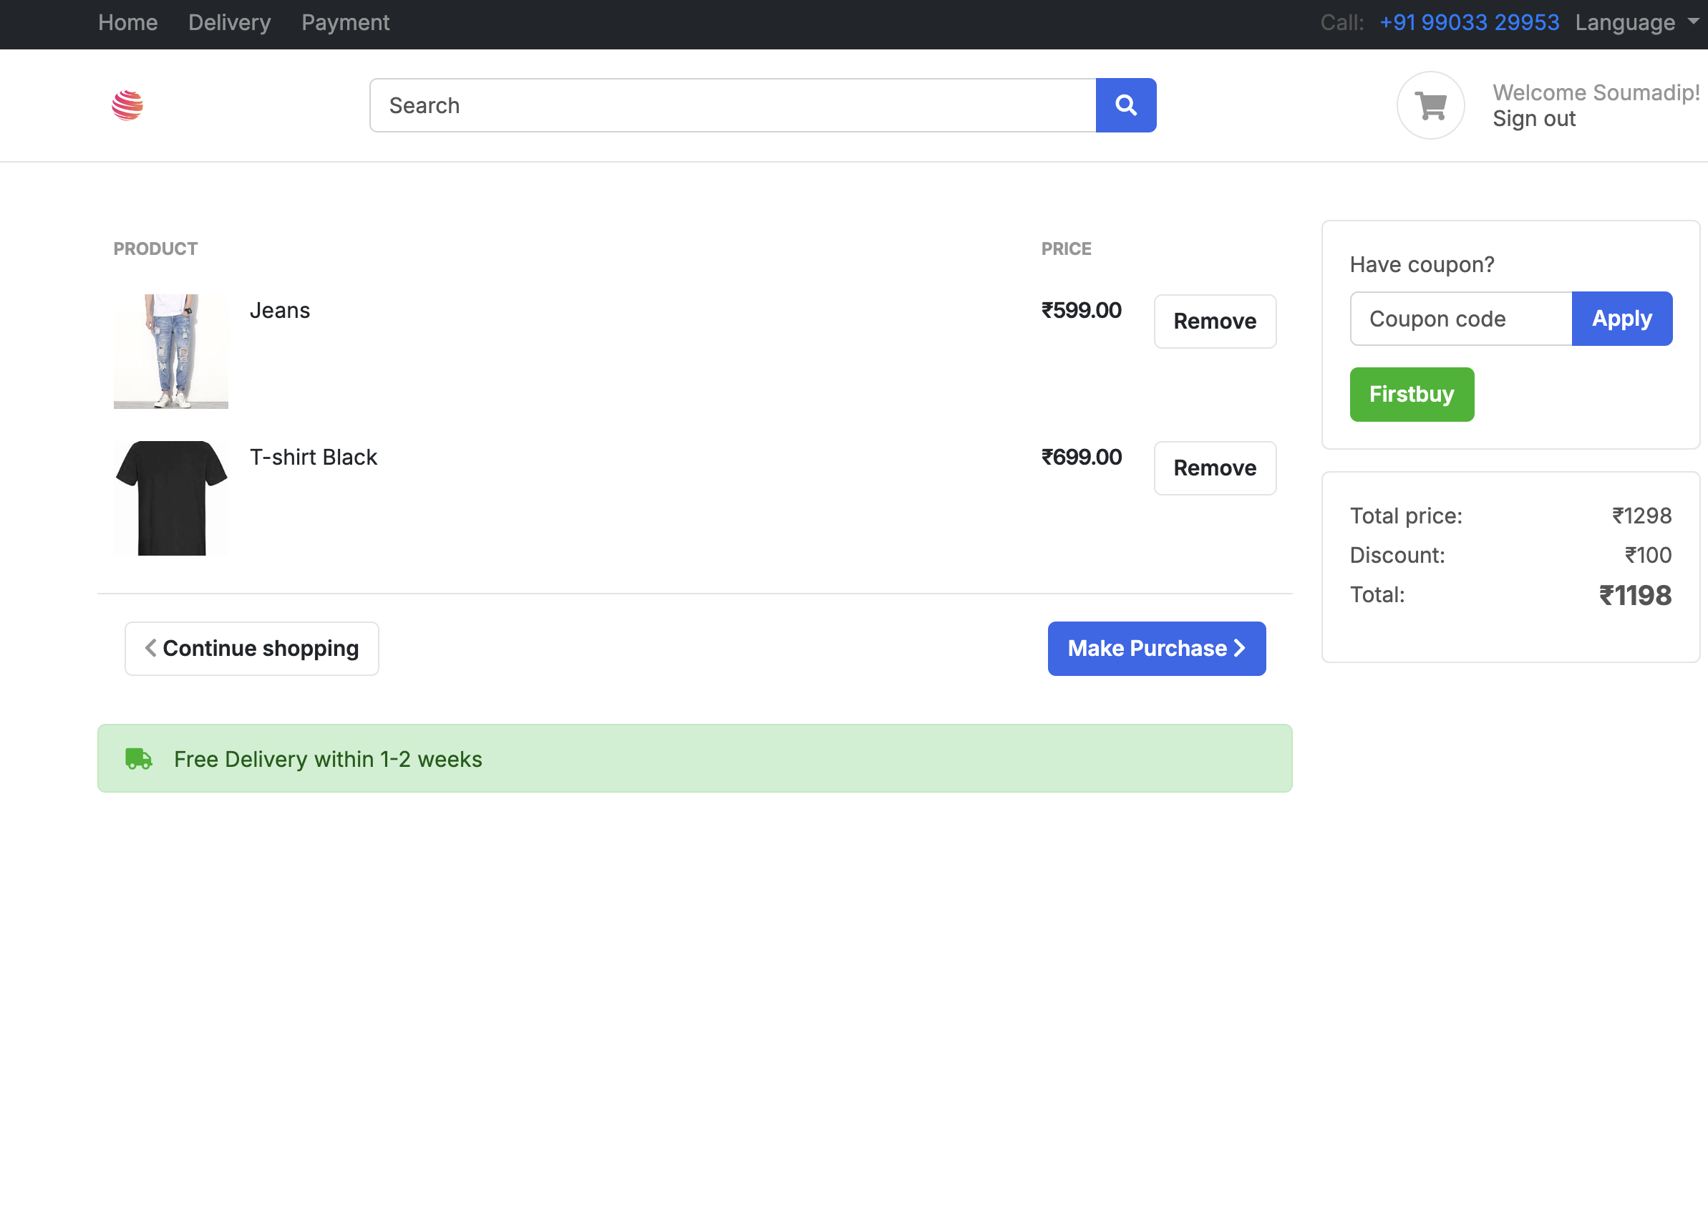
CART PAGE
Functional remove buttons.
Functional coupon adding discount system.
Dynamically changing prices with or without discount.
Functional Make Purchase button which directly redirects to razorpay payment gateway.

Slide 9
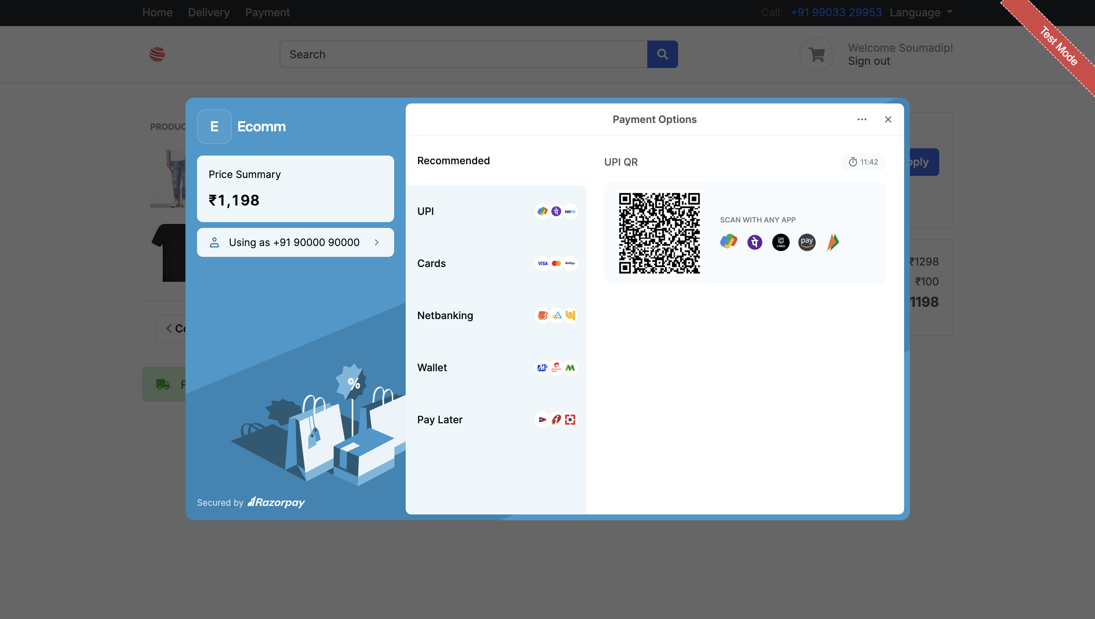
RAZORPAY PAY PAYEMENT PAGE

Slide 10
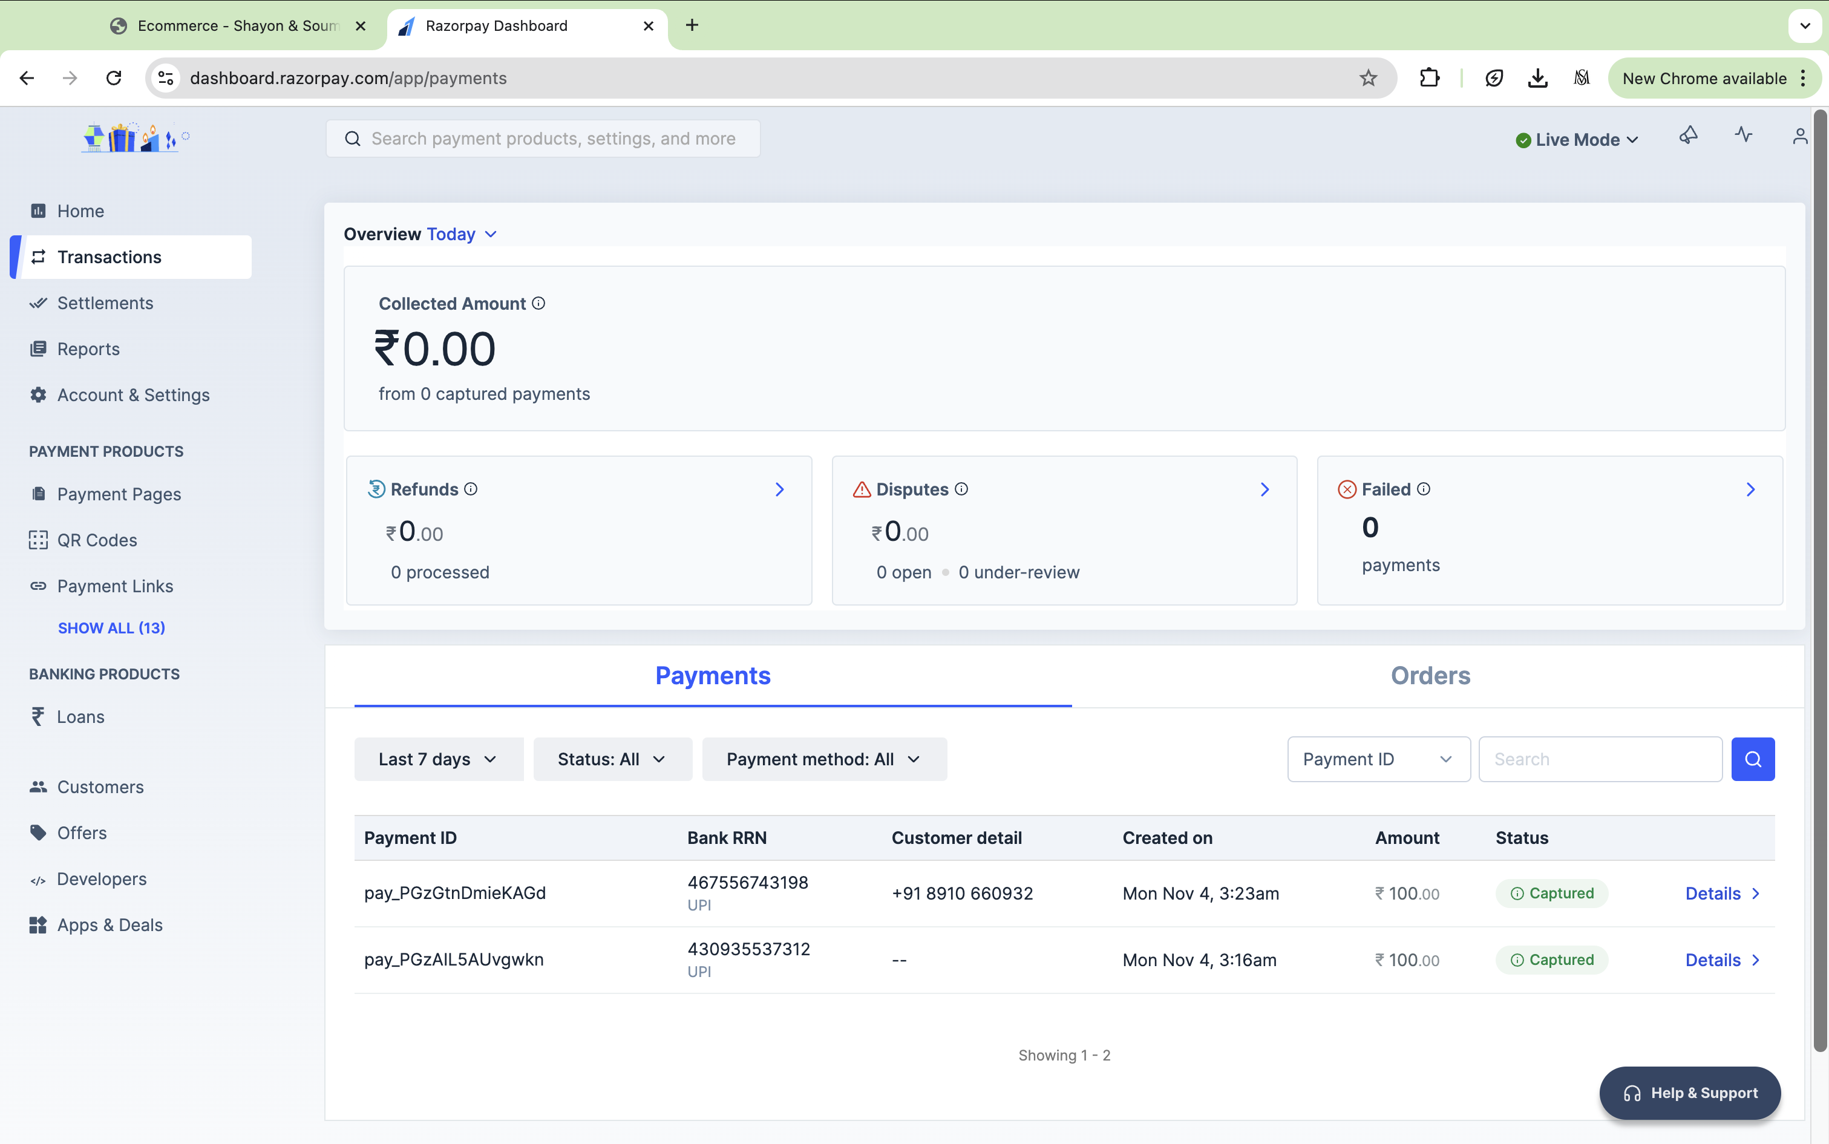
TRANSACTIONS HISTORY

Slide 11
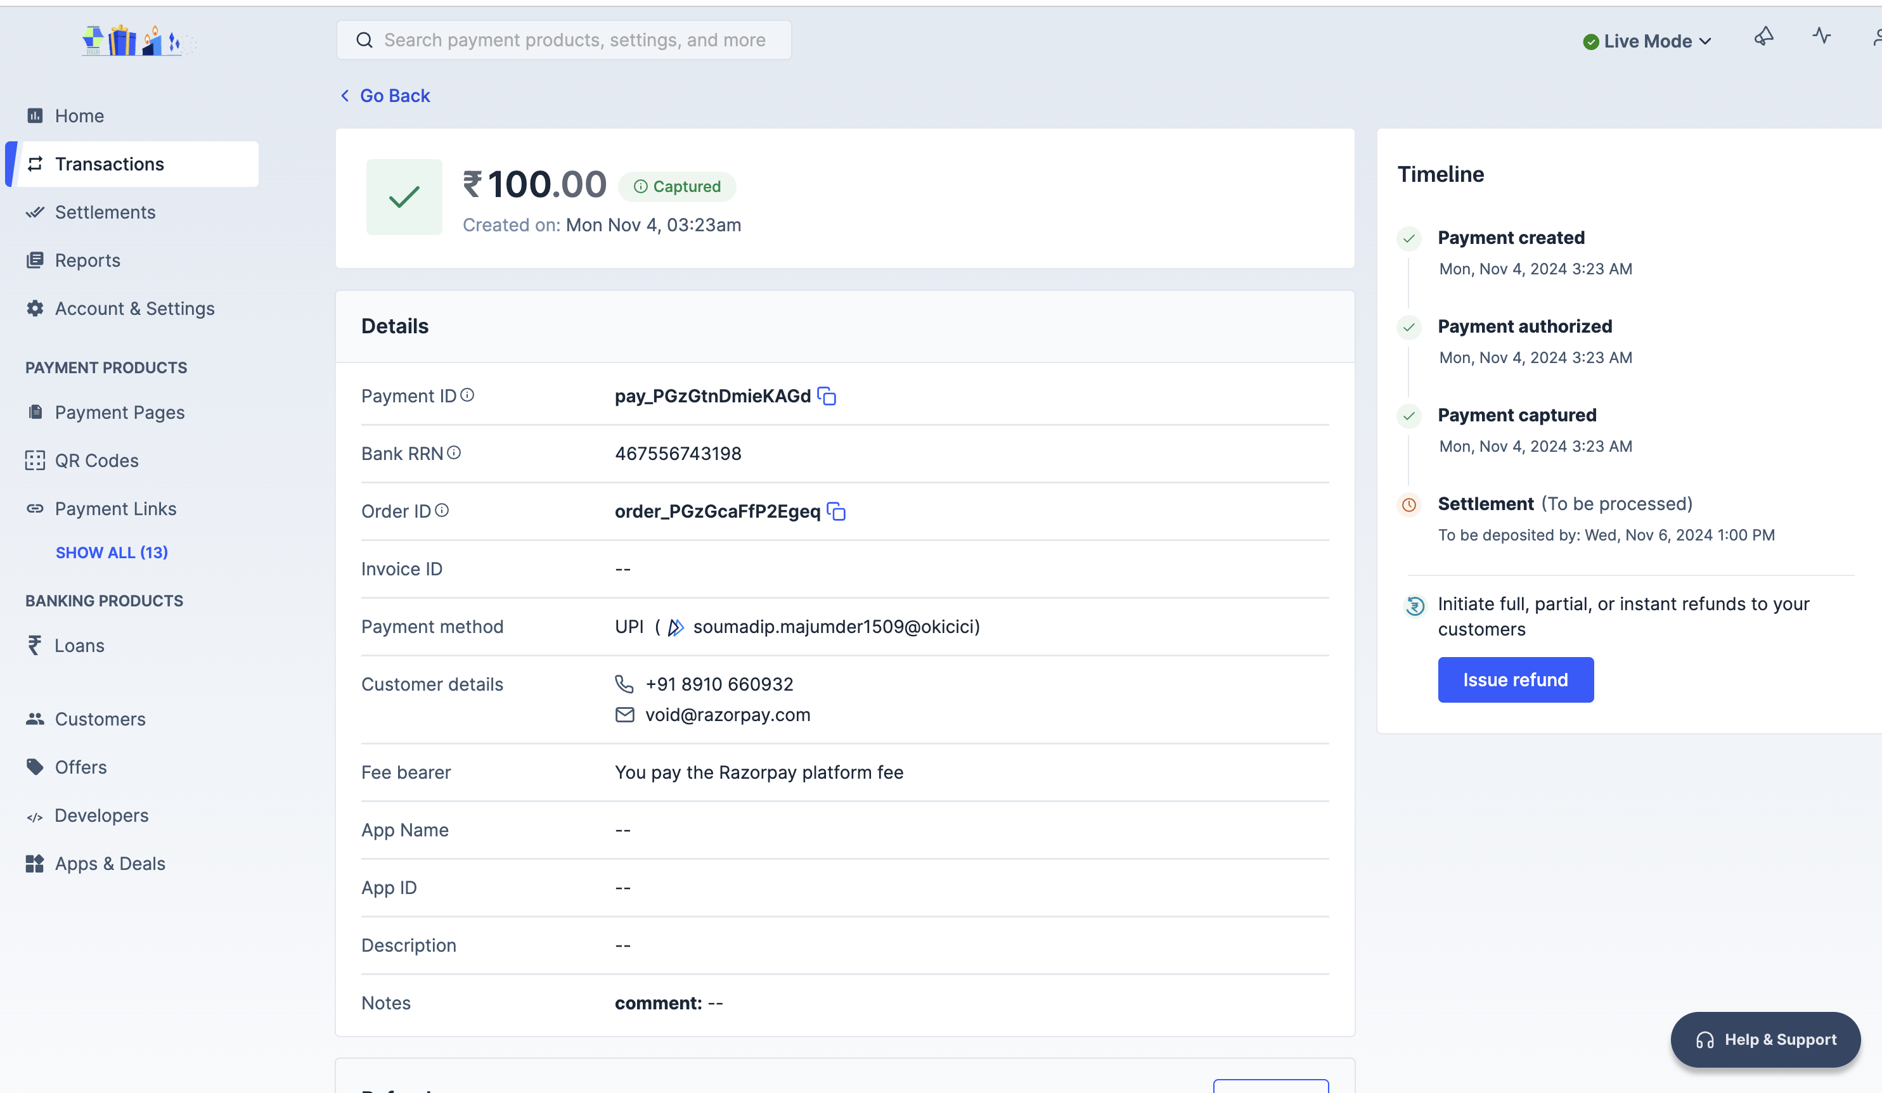
TRANSACTION DETAILS
Shows transaction amount, date, and time.
Gives all information like payment ID, Order ID, and customer details.
Also, has feature to issue refund to customers.
Further can be used as bills

